Slide 1
CARDS 302: Claims Expenditure Reporting, Assessments, Invoicing, and Payment Processing
CARDS Enhancements 2025
State of Nevada Workers’ Compensation Section (WCS)

Slide 2
Overview
Objectives
CARDS 203: Audits, Fine, and Payments
Audience: WCS SMEs
Prerequisites: None
Course Length: 1 hour
At the completion of this course, trainers will be able to guide insurer users through the claims expenditure reporting, assessment, invoicing, and payment processes.

Slide 3
CARDS 302: Claims Expenditure Reporting, Assessments & PP
TRAINING MODULE
Supporting the CARDS 2025 Enhancements Release

Slide 4
Overview
Objectives
Training Course: CARDS 302: Claims Expenditure Reporting, Assessments, Invoicing, and Payment Processing
Audience: Insurer CARDS Users
Prerequisites: N/A
Course Length: 1 hour
At the completion of this course, training participants will be able to navigate through the claims expenditure reporting, assessment, invoicing, and payment processes.

Slide 5
Claims Expenditure & Premium Data Reporting
BIANNUAL WEBFORM SUBMISSION

Slide 6
Claims Expenditure & Premium Data Reporting
Objectives
Overview
User permissions
Notifications
Navigation
Submission
Verification
Reports
At the completion of this module, training participants will be able to complete their biannual Claims Expenditure and Premium Data reporting.
Notes:
TIP: Use this slide as the 2nd slide in each Module deck. If the module is broken down into sub-sections, then use this slide after each Section Divider.

Slide 7
Insurer Claims Expenditures & Premium Data Webform
OVERVIEW
The Insurer Claims Expenditures & Premium Data Webform provides a way for insurers and TPAs to submit bi-annual claims expenditure and premium data for the purpose of calculating assessments. Some things to note about the webform:
Data call windows open twice a year to collect expenditure data over a six-month period
Data collected for the July-December period is collected from January 31st – February 28th
Data collected for the January-June period is collected from July 31st – August 31st
Verification period opens at the end of the year, allowing users to validate the previous fiscal year’s data prior to the assessment calculations. The verification window is open from October 31st – January 1st
The webform collects claims expenditure and earned premium data, categorized between mining and non-mining data
TPAs can only enter claims expenditure and premium data as a registered user of the insurer they are associated with

Slide 8
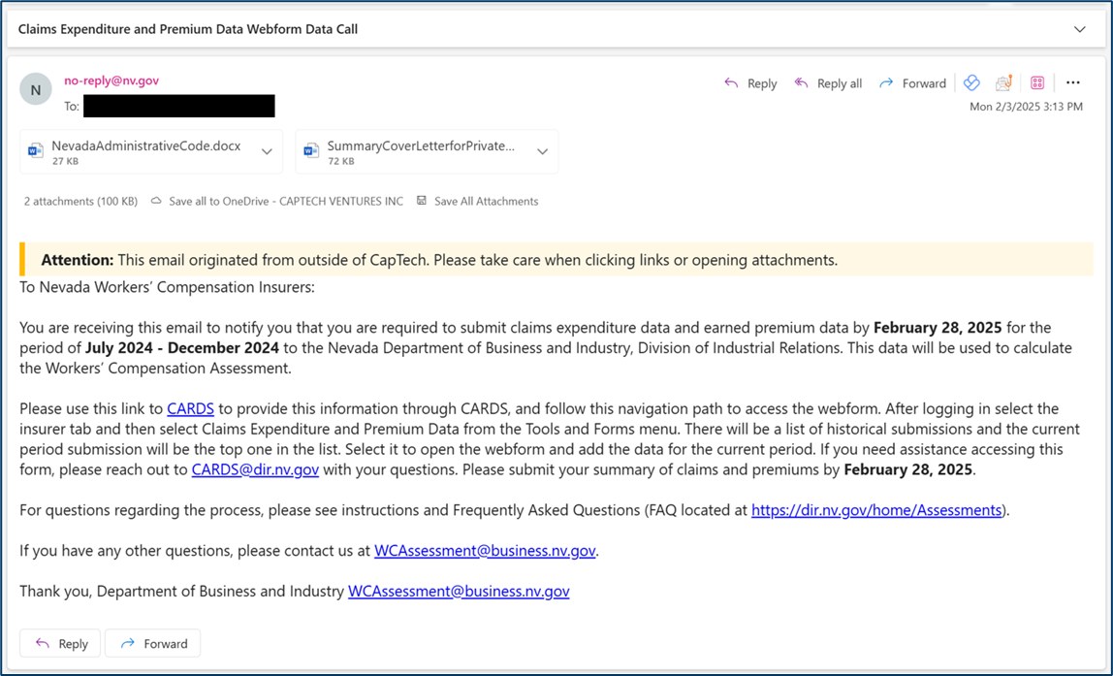
Request for Data Email
When the Claims Expenditure and Premium Data webforms become available, either on January 31st or July 31st, insurers will be notified via email to submit the claims expenditure and earned premium data.

Slide 9
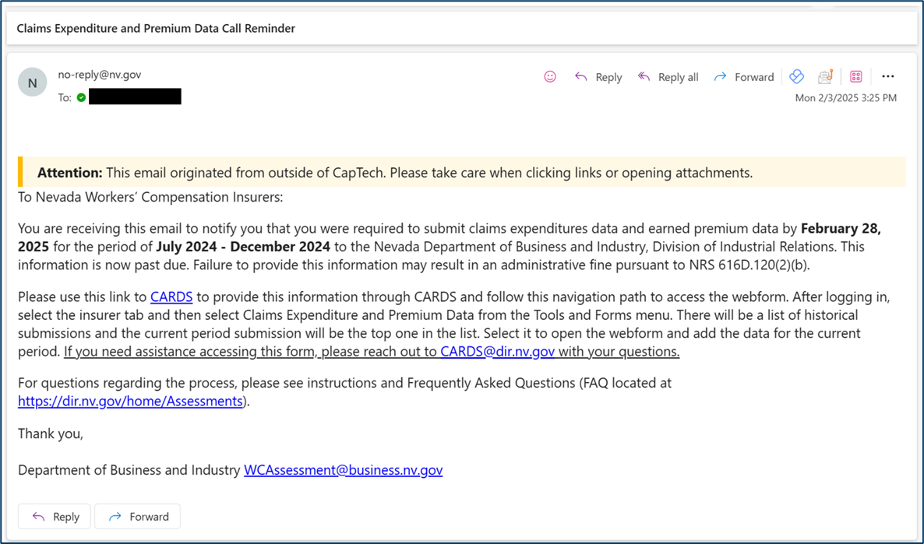
Request for Submission Reminder Email
If an insurer has not submitted the webform when the data call window is active, a reminder will be sent to the insurer 30 days and 45 days after the initiation of the data call window.

Slide 10
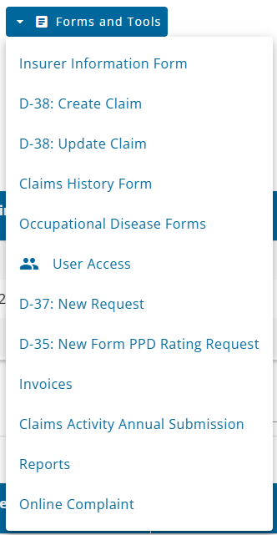
Permissions
ACCESS TO THE CLAIMS EXPENDITURES & PREMIUM DATAWEBFORM
Insurer users with admin access can grant the Claims Expenditure and Premium Data permission to give access to the webform. Permissions can be set from the User Access Management page available from the Forms and Tools menu.

Slide 11
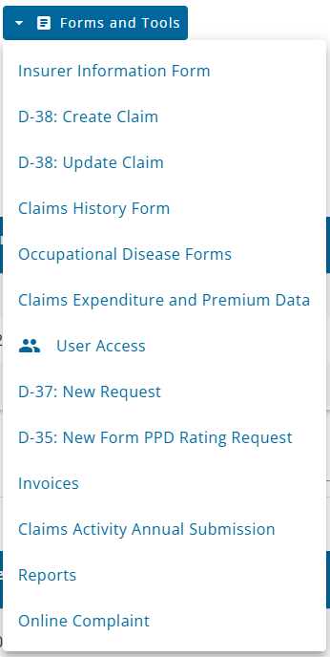
Navigation
Once the permissions have been set and the webform is active for a given data call, users can navigate to the webform in two ways: through the Forms and Tools menu, or from the reminder banner if it is during a submission window.

Slide 12
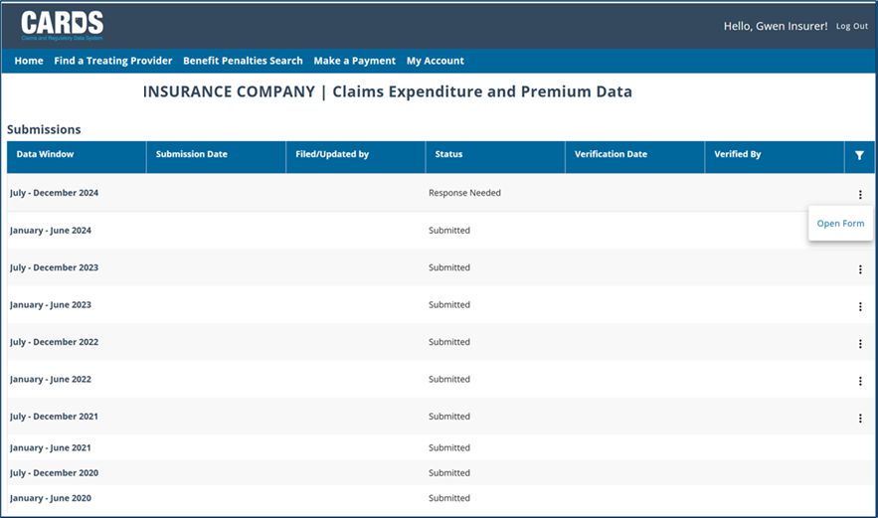
Claims Expenditure and Premium Data Page
When navigating to the webform using the link in the Forms and Tools menu, first you will be brought to the Claims Expenditure and Premium Data Landing Page which stores all the available data call windows for a given Insurer. The new submission will display as “Response Needed” and can be opened using the “Open Form” option in the action menu.
Note: Data was migrated from the legacy system, so you will notice the Submission Date and Filed/Updated by data will not be populated for those years
Note: Edit functionality is only available for the previous 3 years' worth of submissions

Slide 13
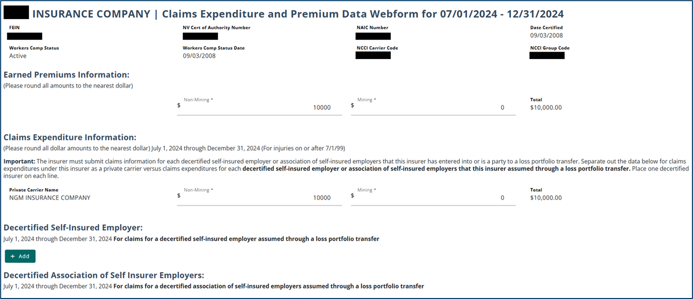
Claims Expenditure and Premium Data Webform
PRIVATE CARRIER WEBFORM
The Claims Expenditure and Premium Data Webform displays insurer information and includes fields to enter information for earned premiums and claim expenditures. Private carriers can submit claims expenditure information for decertified self-insured employers and/or decertified associations of self insurer employers.

Slide 14
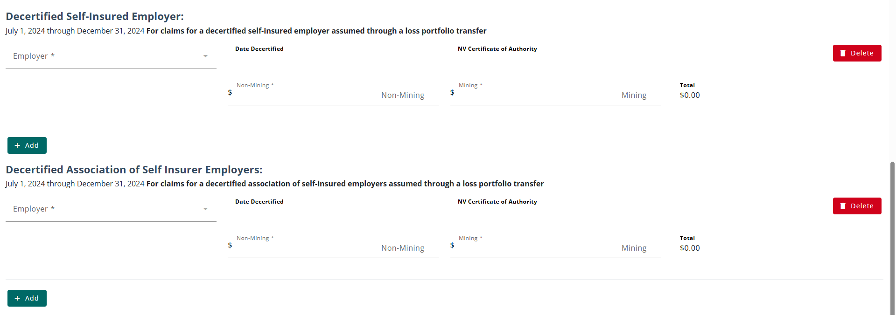
Additional Sections for Private Carriers
DECERTIFIED SELF-INSURED EMPLOYER & DECERTIFIED ASSOCIATION OF SELF INSURER EMPLOYERS
By selecting the Add button in the Decertified Self-Insured Employer or Decertified Association of Self Insurer Employers sections, users can add information for each employer record, as necessary.

Slide 15
Submitting the Webform
Before submitting the webform, users must declare the information submitted is correct. Once the form is submitted, the user is brought back to the Claims Expenditure and Premium Data Page, and the status of the form will update to ‘Submitted’.

Slide 16
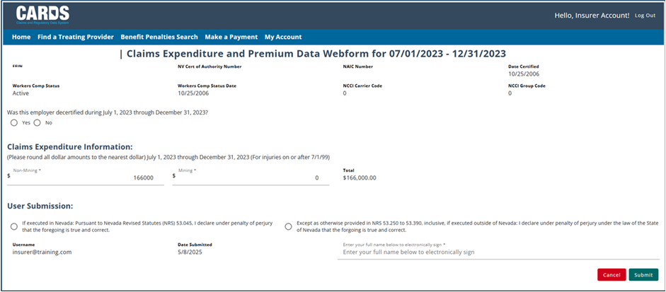
Claims Expenditure and Premium Data Webform
SELF-INSURED EMPLOYER/ASSOCIATION WEBFORM
The Claims Expenditure and Premium Data Webform for Self-Insured Employers and Association of Self-Insured Employers only collects claims expenditure data.

Slide 17
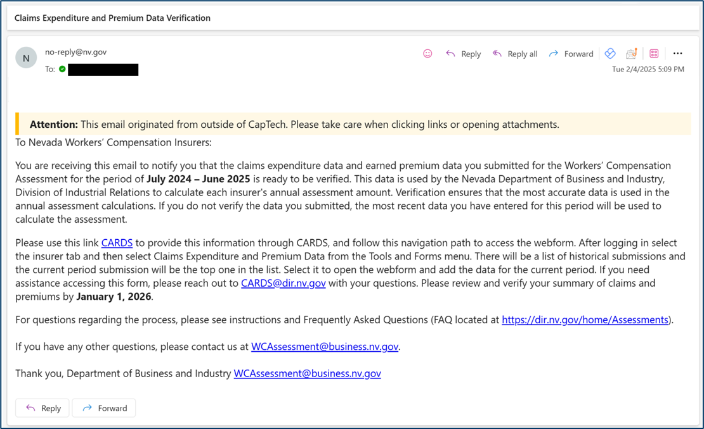
Claims Expenditure and Premium Data Verification Email
After data has been submitted, the data must be verified. Notification will be sent to all Insurers on October 31st requesting to verify the data that had been submitted for the previous fiscal year. The verification window will be open until January 1st.

Slide 18
Verifying the Claims Expenditure and Premium Data Filing
VERIFICATION REMINDER
When the verification window is active, a message will be displayed on the user's external homepage.

Slide 19
Verifying the Claims Expenditure and Premium Data Filing
ACCESSING THE VERIFICATION FORM
You can fill out the verification form by selecting “Verify” in the action menu on a Data Window with an Awaiting Verification status.

Slide 20
Verifying the Webform
The top of the webform is available as read-only to review submitted information. If you feel any of the information needs to be changed before you verify, the Edit Form button will take you back to the editable version of the form.

Slide 21
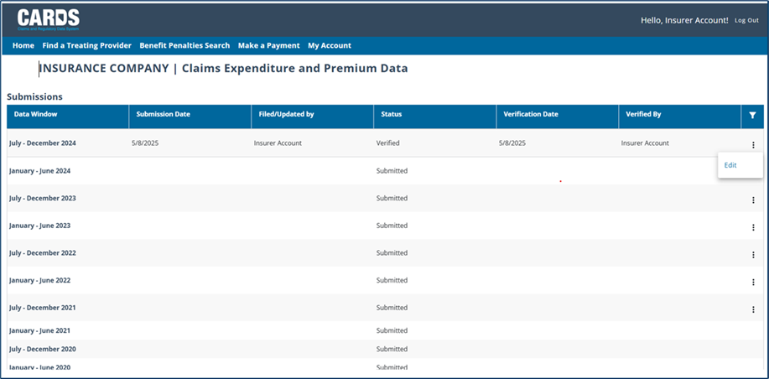
Confirming Verification
After the verification is complete, the status of the submission will update to Verified and the action menu will no longer have Verify as an option.

Slide 22
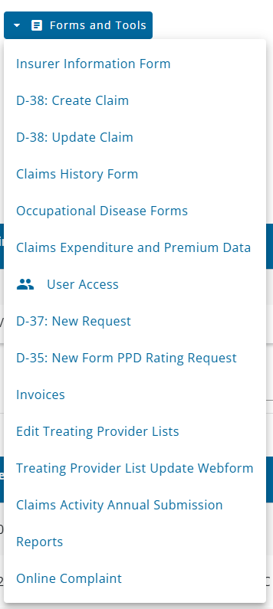
Claims Expenditures & Premium Data Report
NAVIGATING TO THE REPORT
The Claims Expenditures & Premium Data report will be available to users who have the Claims Expenditure and Premium Data and Insurer Reports permissions and have navigated from an insurer entity. All reports are accessed through the Forms and Tools menu.

Slide 23
Claims Expenditures & Premium Data Report
RUNNING THE REPORT
On the reports page users have the option to select parameters for the report including output format, start year, and end year.

Slide 24
Claims Expenditures & Premium Data Report
REPORT OUTPUT
Once the report is generated, the file will be downloaded to the browser and be viewable to the users.

Slide 25
Questions?
CARDS 302: Claims Expenditure reporting, assessments, invoicing, and payment processing
For any questions after this presentation, reach out to CARDS@dir.nv.gov
Notes:
Note: Replace the date placeholder with the date of the presentation to stakeholders and update contact information as necessary

Slide 26
Payment Processing & Recording
PAYING INVOICES IN CARDS

Slide 27
Payment Processing & Recording
Objectives
User permissions
Notifications
Navigation
Payment methods
Reports
At the completion of this module, training participants will be able to view and pay invoices in the CARDS system
Notes:
TIP: Use this slide as the 2nd slide in each Module deck. If the module is broken down into sub-sections, then use this slide after each Section Divider.

Slide 28
Assessment Process and Paying Invoices
OVERVIEW
Using the data submitted on the Claims Expenditure and Premium Data webform, assessments will be calculated for the insurers and invoices issued to collect payments on each of the three assessments. Some important notes about the Assessment process:
Each insurer’s assessment is based on their proportional share of statewide claims expenditures or premiums.
The three assessment types are: Estimated, Final, and COLA
The Estimated Assessment is done at the beginning of the fiscal year and is calculated based on an average of the previous 3 years' worth of claims expenditure data or premium data
The Estimated Assessment will be split into installment payments that will be paid over a four-month period (December – March)
The Final Assessment is done after the fiscal year is over and will determine whether the estimated payments resulted in under or over payments, and either an additional amount will be invoiced, or a refund will be processed for the Insurer
The COLA Assessment determines each insurer’s share of COLAs for Permanent Total Disability and Survivor’s Benefits.
Invoices that are not paid in a timely manner may become eligible for a fine/penalty

Slide 29
Important Dates to Note for the Assessment Process
Estimated Assessment
Sept 30 Invoice Emailed
Dec 1- first installment due
Jan 5- email sent if no payment
Jan 12- delinquent letter mailed
Jan 22- referral for collections and penalties if no payment
Jan 1- 2nd installment due
Feb 1- 3rd installment due
Mar 1- 4th installment due
Final/COLA Assessment
May 31 Invoice Emailed
June 30 Final and COLA assessment due or refunds paid
August 5- email sent if no payment
August 22- referral for collections and penalties if no payment
Data Calls for Claims Expenditure and Premium Data
Jan 31 email requesting data for previous July- Dec
July 31 email requesting data for previous Jan- June
Oct 31 request for verification of data emailed
Jan 1 verification process ends

Slide 30
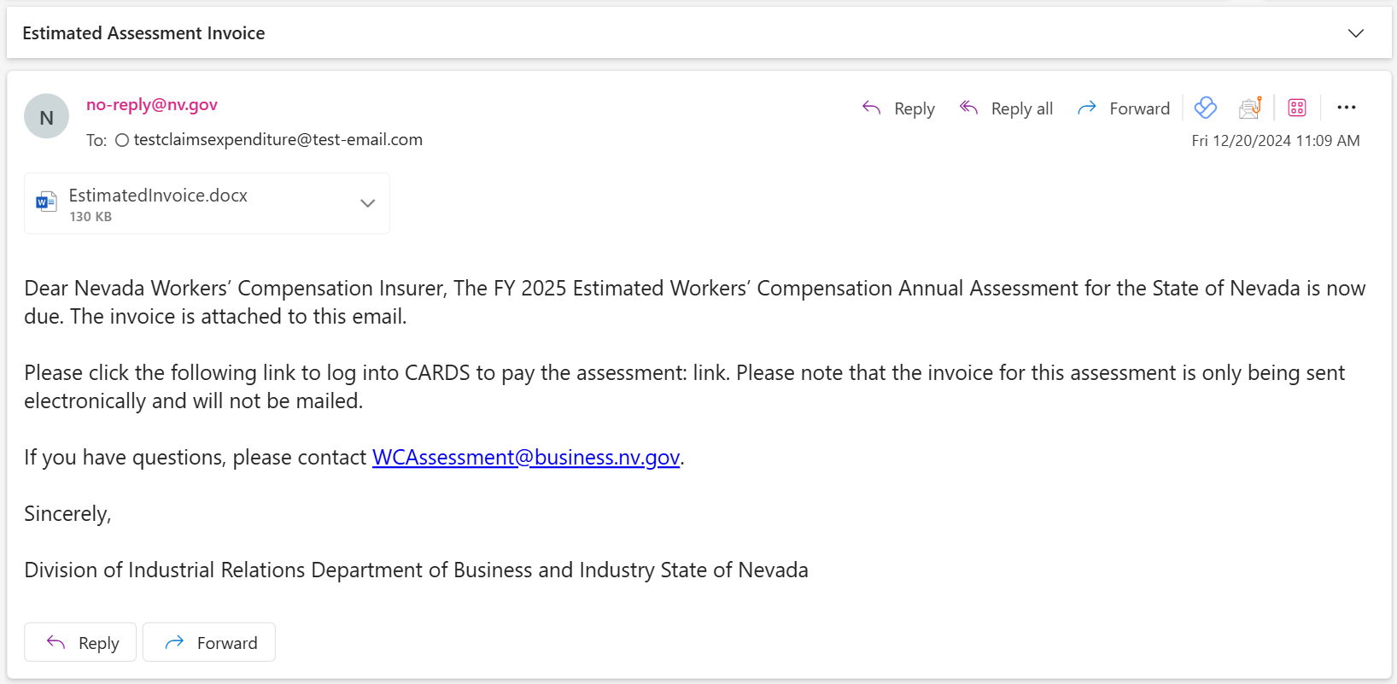
Notification of Invoice Due
Once the internal process of calculating the Estimated, Final, and COLA assessment occurs, invoices will be generated, and Insurers will be notified of the assessment payment via email.

Slide 31
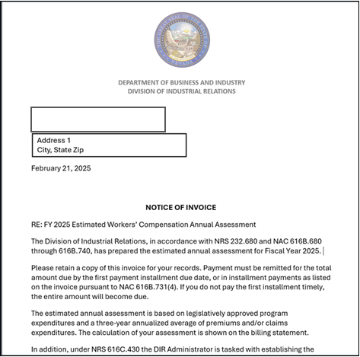
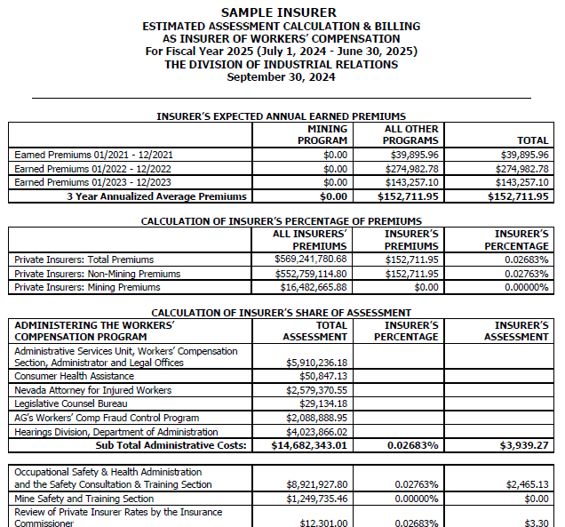
Notification of Invoice Due
The invoice attached to the email will include the cover letter and invoice for the associated assessment.
Insert dummy invoice here

Slide 32
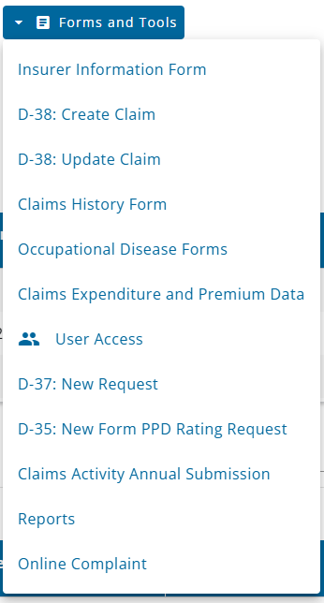
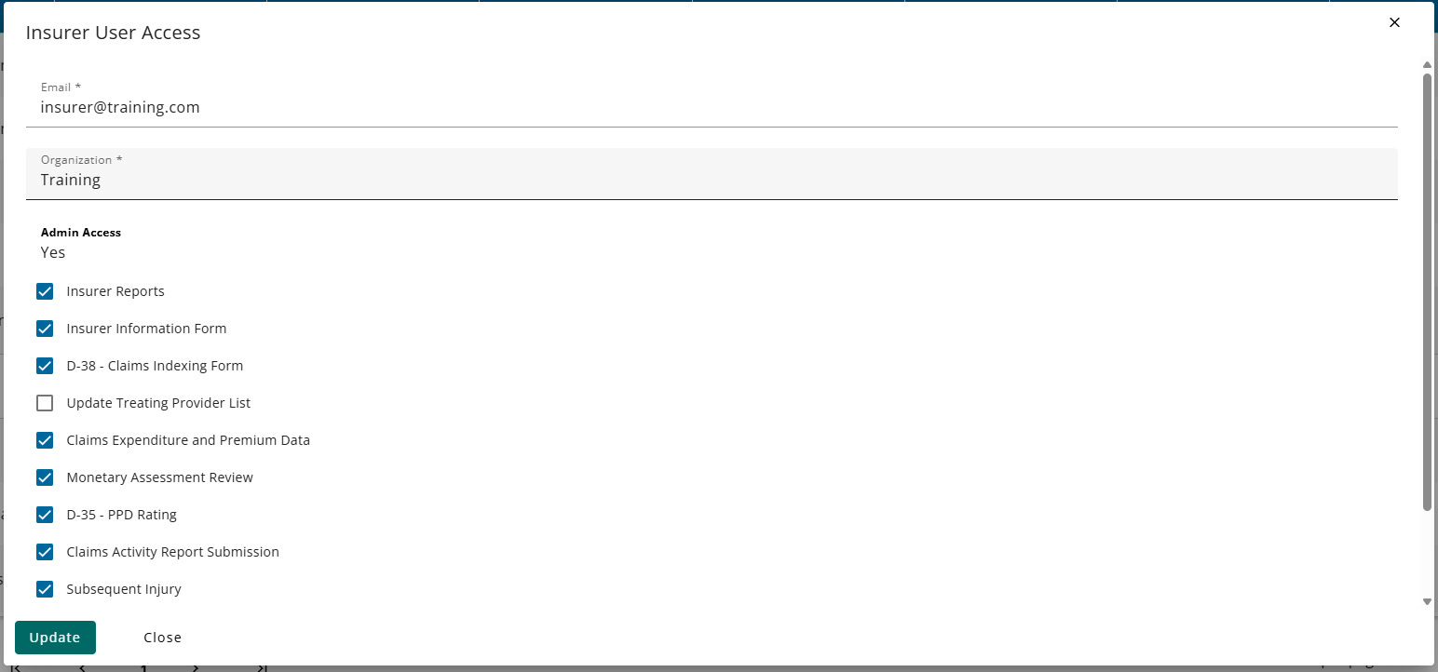
Permissions
ACCESSING INVOICES
Insurer users with admin access can update user permissions to view invoices by selecting the Monetary Assessment Review permission on the User Access Management page.

Slide 33
Notifications for Invoices
Insurers will be notified via email when they have new invoices and reminder emails as the payment due date approaches. If an insurer has any unpaid invoices, a banner will also display on the dashboard until all invoices have been paid.

Slide 34
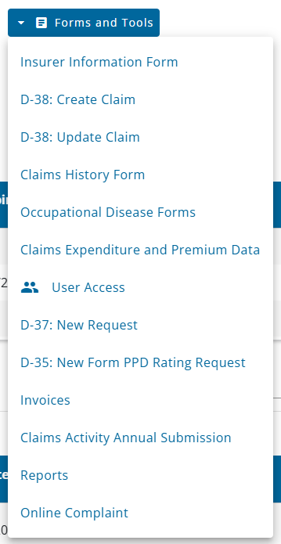
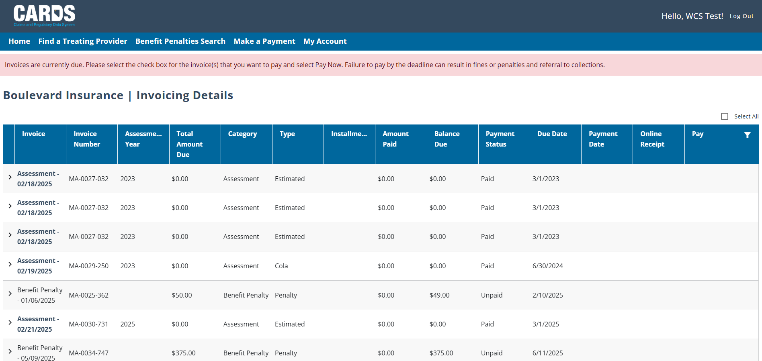
Navigation
PAYING INVOICES AS AN AUTHENTICATED USER
When you are logged in to CARDS and have the correct permissions, you can access the Invoicing Details page by selecting Invoices on the Forms and Tools menu.

Slide 35
Paying Invoices
SINGLE SELECT AND MULTI-SELECT OPTIONS
You can choose to select individual invoices to pay by expanding an invoice record and selecting the Pay Now box. You also have the option of selecting all invoices to pay at once by checking the box at the top right of the Invoicing Details table.
Notes:
Payments by credit card or e-check

Slide 36
Paying Invoices
SINGLE SELECT AND MULTI-SELECT OPTIONS
After selecting the invoices you wish to pay, you can press the Pay Now button at the bottom of the page. A pop-up modal will display the total of all selected invoices and prompt you to the payment screen.
Notes:
Payments by credit card or e-check

Slide 37
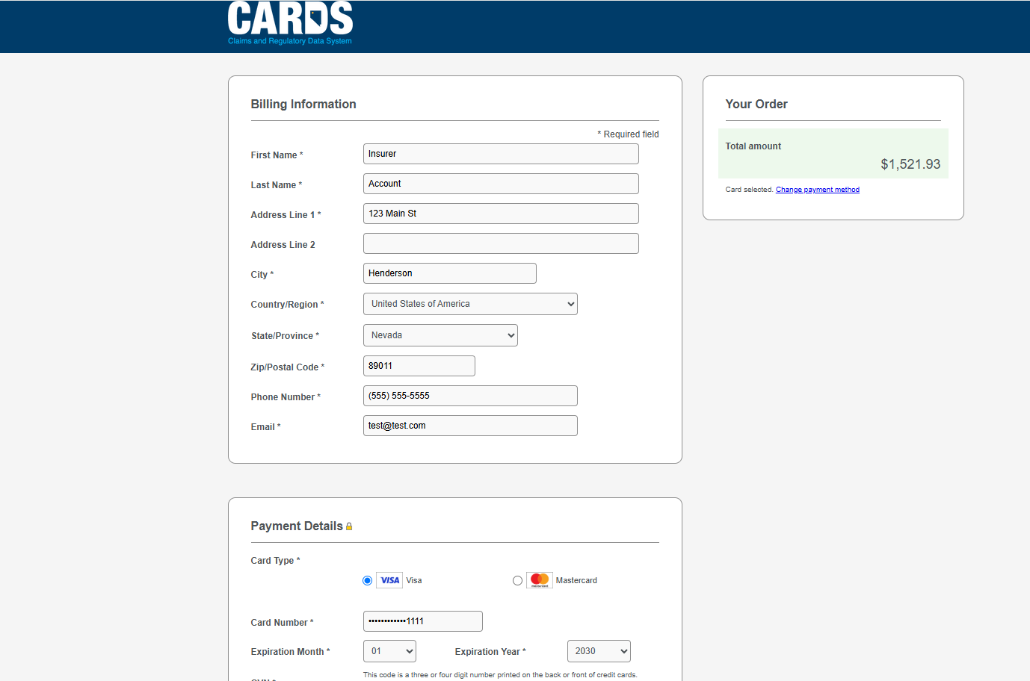
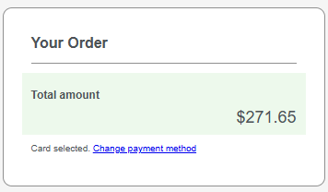
Payment Screen
PAYMENT OPTIONS
You will have the option to pay with either a credit card or an e-check. You can change the payment method by selecting the ‘Change payment method’ link in the Your Order block. The default payment method is a credit card.

Slide 38
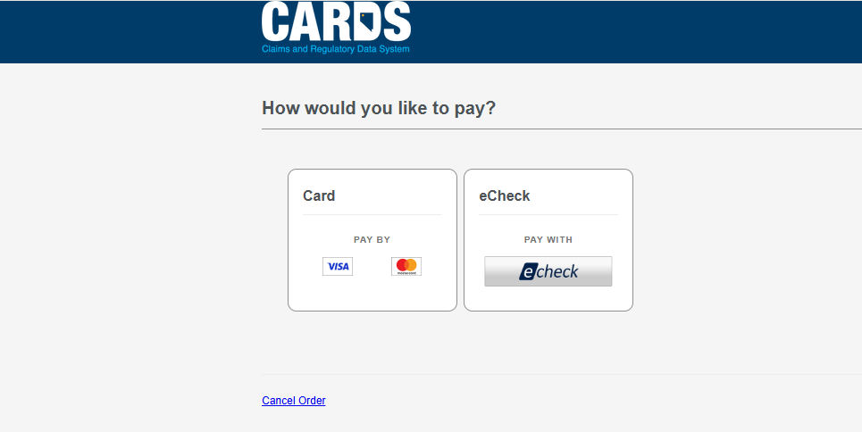
Payment Screen
PAYMENT OPTIONS
Once you have selected ‘Change payment method’, you will be able to select how you would like to pay.

Slide 39
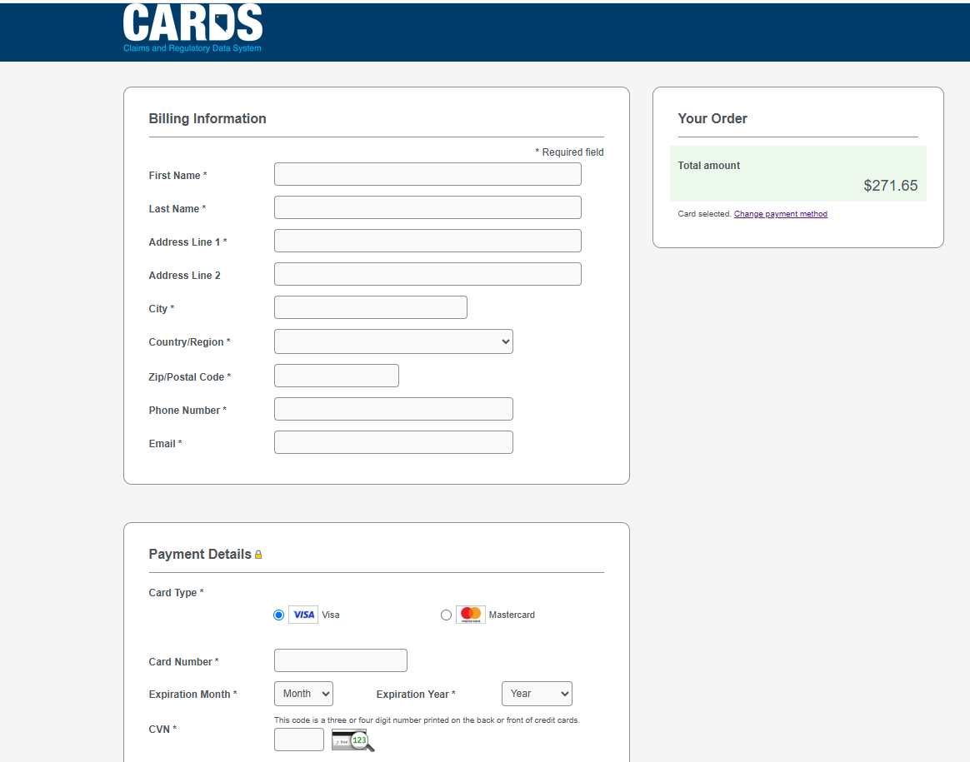
Payment Screen
CREDIT CARD PAYMENT
Note: The payment receipt will be sent to the email entered in the billing information.

Slide 40
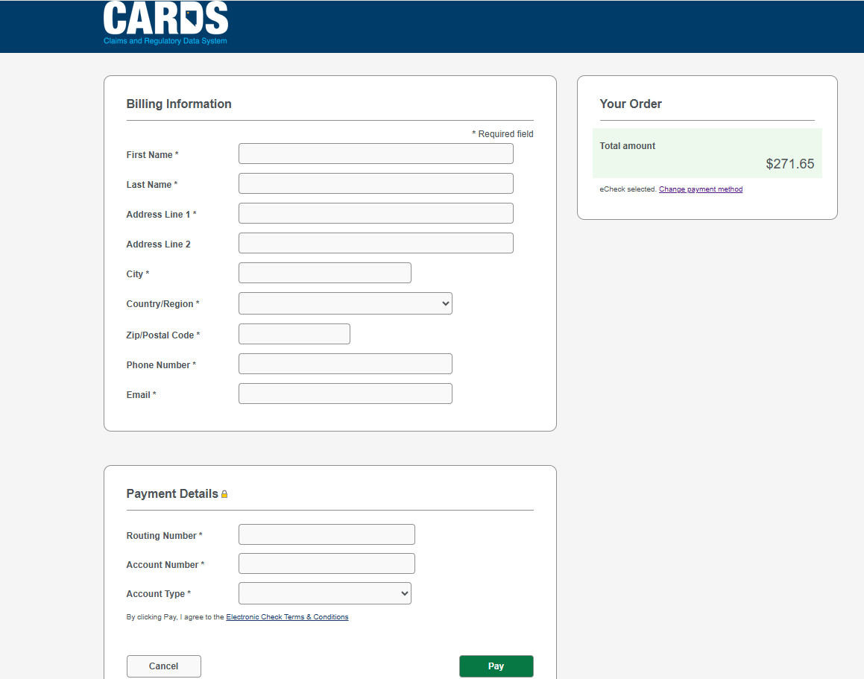
Payment Screen
E-CHECK PAYMENT

Slide 41
Payment Confirmation
After you have completed payment, you will be brought to a Payment Confirmation page where you can review your payment details.

Slide 42
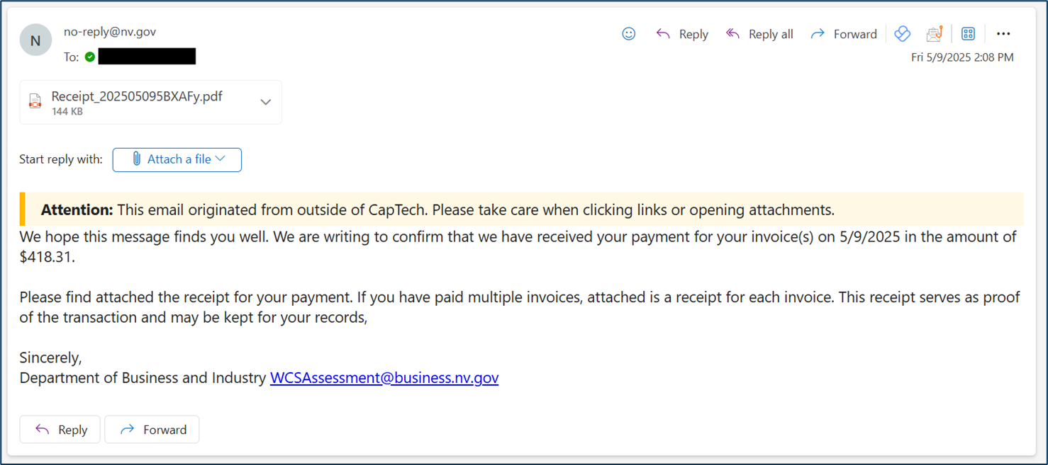
Payment Confirmation Email
After you have completed payment, you will be sent a Payment Confirmation via email where you can review your payment details.

Slide 43
Reviewing Past Payments
FILTERING BY PAID INVOICES
You can use the filter button to view invoices on the Invoicing Details page by status. When you expand an individual invoice record you can see the payment date and view the receipt. Selecting receipt will bring you back to the Payment Confirmation page.

Slide 44
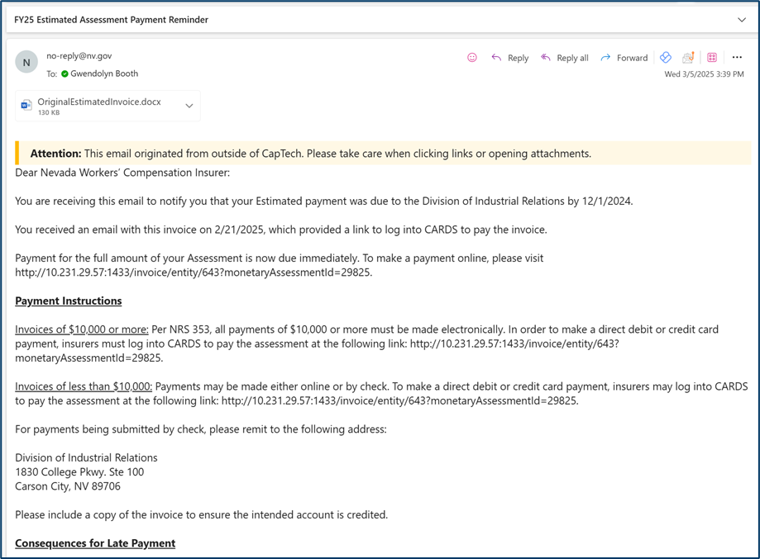
Reminder Emails
A reminder email to pay the assessment will be sent to the Insurer if payment has not been received past the due date of the assessment. If payments are still not received within 7 days of the email, the process of determining whether to issue fines will proceed for that Insurer.

Slide 45
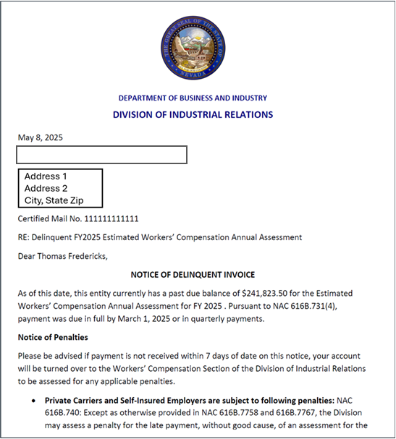
Delinquency Process
If an assessment payment is still not received within 7 days of receiving the email reminder, the internal WCS staff will issue a Delinquency Notice to the Insurer, demanding a payment to be made within an additional 7 days. Notification will be sent via certified mail at this time.

Slide 46
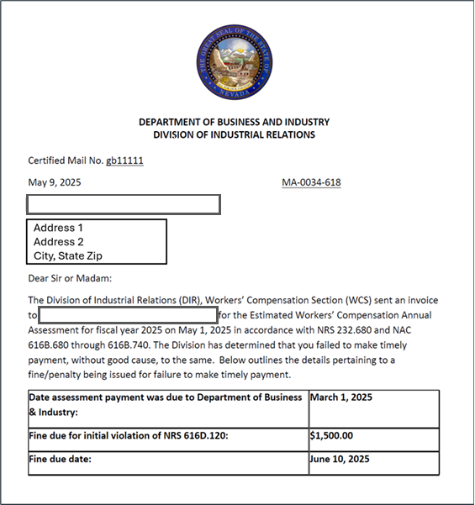
A Note on Payment Status
If a payment is still not received after receiving the Delinquency Notice, it is eligible to be reviewed for a fine by the WCS staff. If Insurer becomes delinquent, the assessment amount will be sent to collections and a fine will be issued to the Insurer. The status of the payment will reflect the “Sent to Collections” status.
At this time, the assessment amount will need to be made to the Nevada State Controller’s Office. The issued fine will be available for payment in the CARDS application

Slide 47
Fine Process
Once a payment is Sent to Collections, you will no longer have the ability to pay the Invoice using the CARDS application.

Slide 48
Invoice and Payment Report
The Invoice and Payment report will be available to users who have the Monetary Assessment Review permission and have navigated from an insurer entity. All reports are accessed through the Forms and Tools menu.

Slide 49
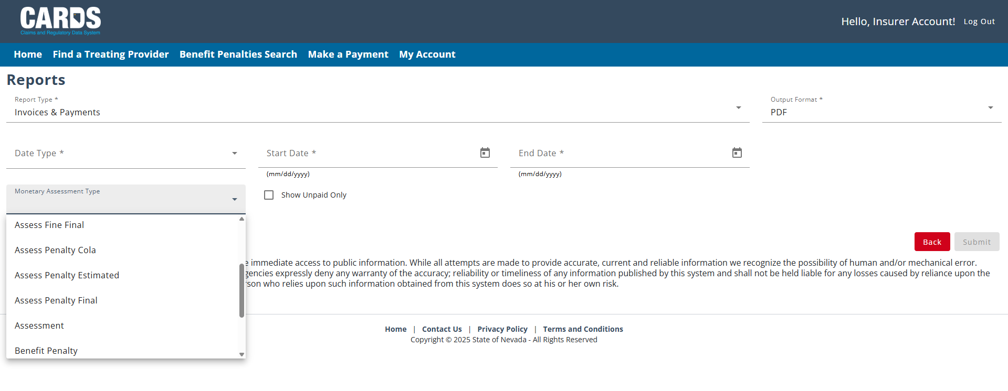
Invoice and Payment Report
RUNNING THE REPORT
On the reports page users have the option to select parameters for the report including Date Type, Start Date, End Date, and Monetary Assessment Type.

Slide 50
Example Report
Once the report is generated, the file will be downloaded to the browser and be viewable to the users. The report will summarize the invoices related to the selected insurer based on the search criteria select on the report page.

Slide 51
Questions?
CARDS 302: Claims Expenditure reporting, assessments, invoicing, and payment processing
For any questions after this presentation, reach out to CARDS@dir.nv.gov
Notes:
Note: Replace the date placeholder with the date of the presentation to stakeholders and update contact information as necessary

